Slide 1


Customer Sales Analysis
Supermarket project

Slide 2
Team
Youssef Azam Mahfouz
Mostafa Gamal Arafa
Menna Mostafa Salah
Maryam omar ahmed
Hossam Ahmed Ali

Slide 3

Agenda
Introduction
Project Goals
Entity-Relationship Diagram (ERD)
Schema
Database Creation in MSSQL
Gathering Business Information
Data Modeling
Data Warehouse
ETL Process in SSIS
Reporting in Power BI
(Cloud (Microsoft Azure
Data analysis using Python
Machine learning model (regression model)
Project Timeline
Conclusion

Slide 4

Introduction
Goal of project : In the modern retail landscape, efficient and accurate data management is crucial for the smooth operation and success of any supermarket. The Supermarket Management System Database project aims to develop a comprehensive database solution that streamlines various aspects of supermarket operations, from inventory management and sales tracking to customer relationship management and business analytics.
This project will encompass the entire lifecycle of database development, including the design, implementation, and deployment phases. The end goal is to create a robust and scalable database in Microsoft SQL Server (MSSQL) that supports the supermarket's business needs and provides actionable insights through advanced reporting and data analytics tools such as Power BI.

Slide 5

Project Goals
Create ERD: Design a detailed Entity-Relationship Diagram (ERD) for supermarket operations.
Convert ERD to Schema: Translate the ERD into a formal database schema with all necessary tables, keys, and constraints.
Create Database in MSSQL: Implement the schema in Microsoft SQL Server, setting up the database structure.
Gather Business Information: Identify key business questions to guide decision-making.
Create Data Model: Develop a data model optimized for performance and scalability.
Create Data Warehouse: Design and implement a data warehouse for comprehensive reporting and analysis.
ETL in SSIS: Use SQL Server Integration Services (SSIS) to develop an ETL process to populate the data warehouse.
Create Reports in Power BI: Develop interactive reports in Power BI to visualize data and provide business intelligence.
Data analysis using Python: Build a notebook to analysis dataset and got more insights and kpi .
ML: Build a machine learning model regression to predict total profit .

Slide 6
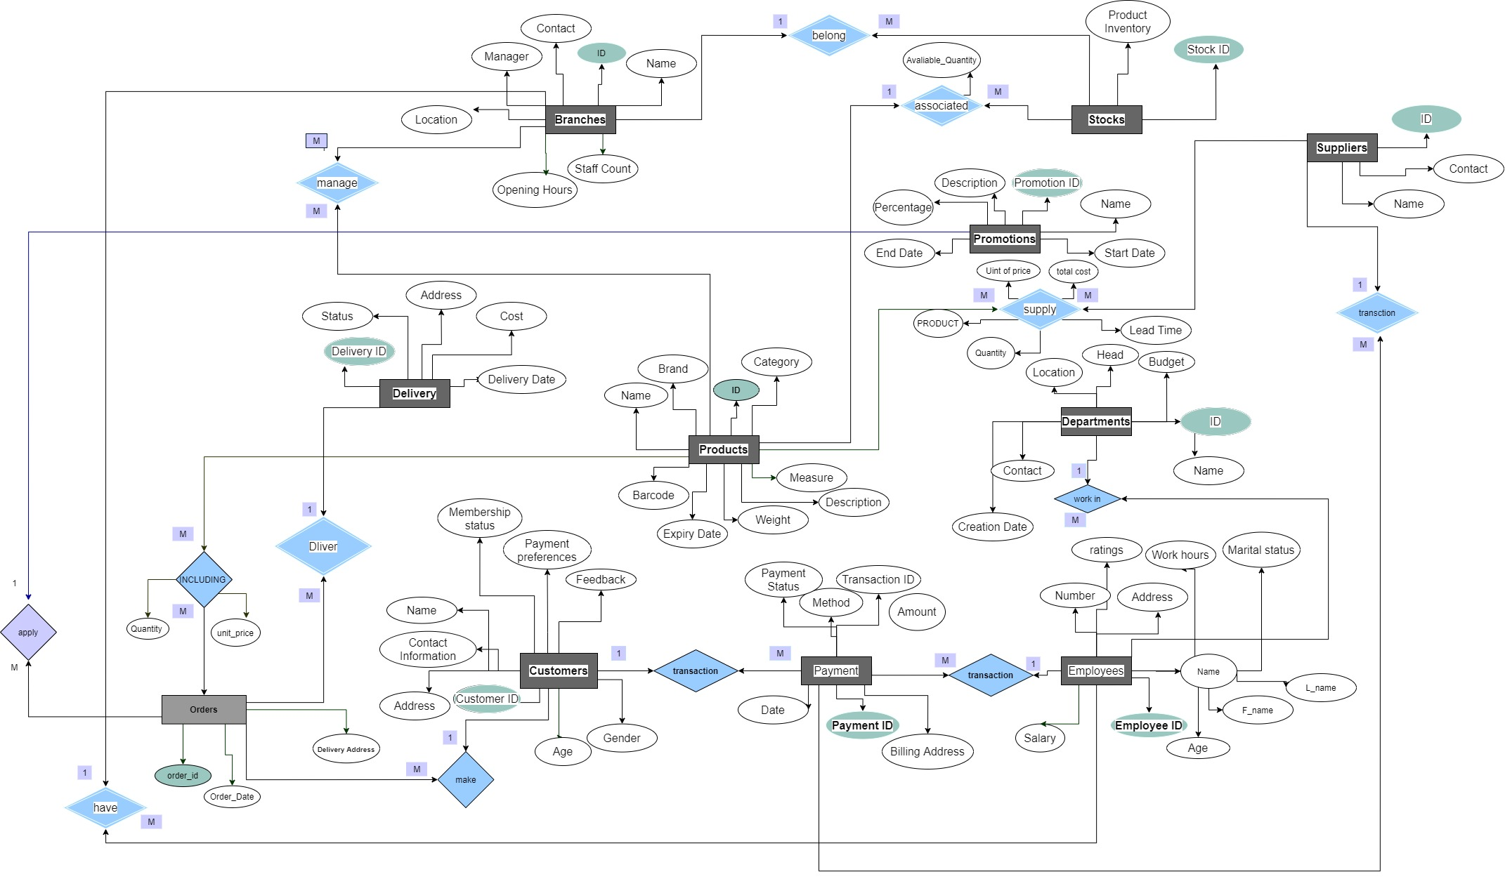
Entity-Relationship Diagram (ERD)

Slide 7
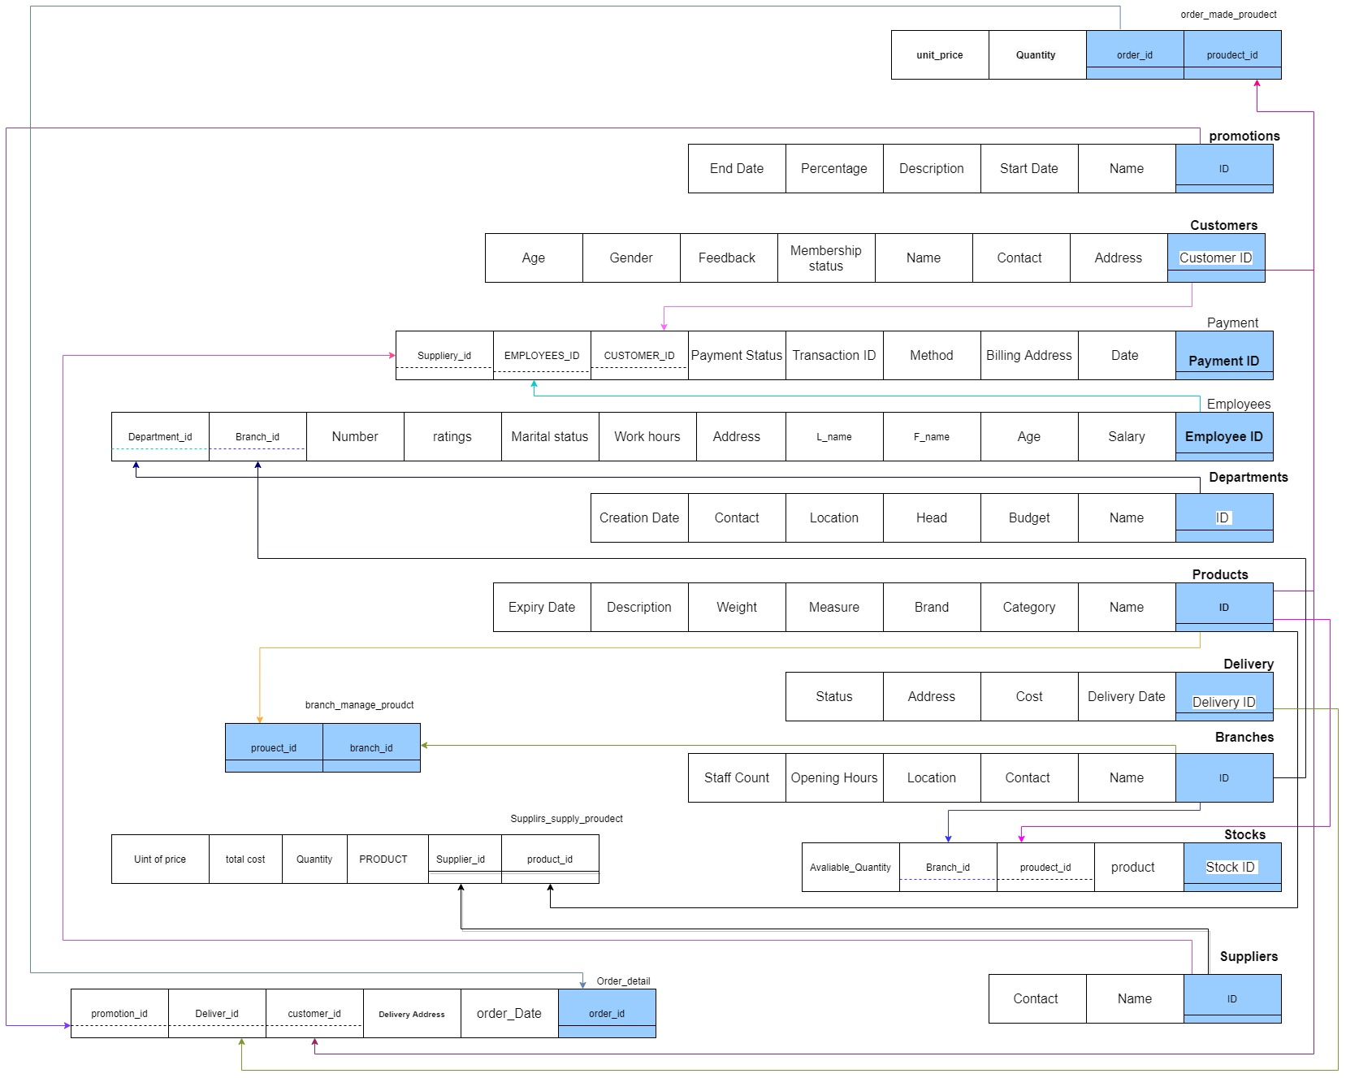
Schema

Slide 8
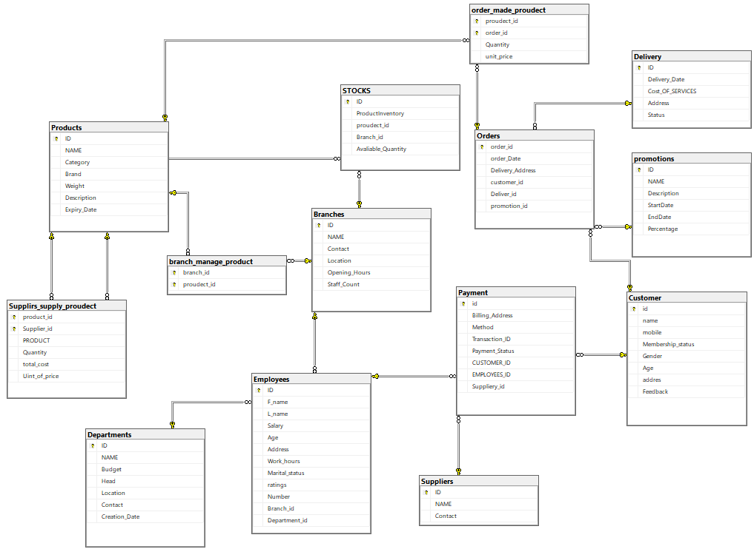
Database Creation in MSSQL

Slide 9

Business Information Questions ?
What are the total sales revenue and quantity sold for each product category?
How do sales vary over time, and can we identify any seasonal trends or patterns?
Which branches are the top performers in terms of sales revenue and profit margin?
What is the sales performance of employees in each branch and department, and who are the top 10 sales representatives and their managers?
What are the current inventory levels of each product in each branch, and how does inventory turnover vary across different product categories and branches?
Which promotions result in the highest increase in sales revenue, and can we quantify the ROI for each promotion campaign?

Slide 10
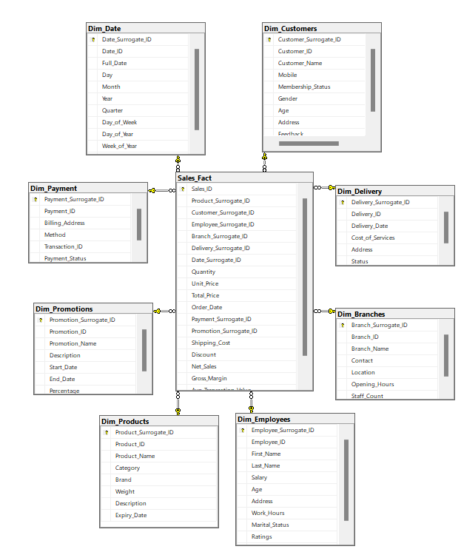
Data Warehouse Design
Star schema

Slide 11
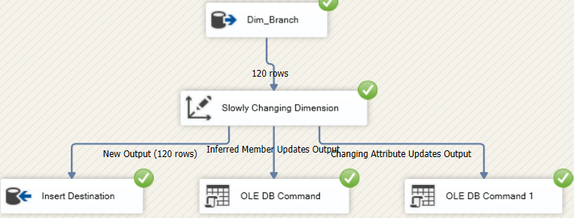
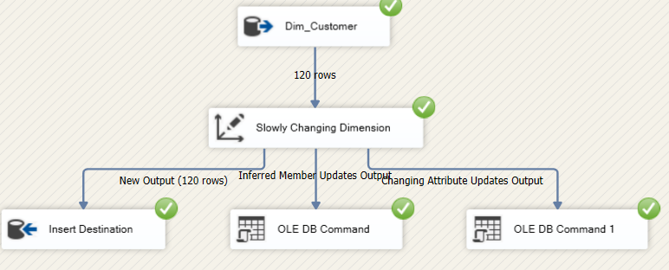
ETL Process in SSIS
Dim_Branches
Dim_Customer

Slide 12
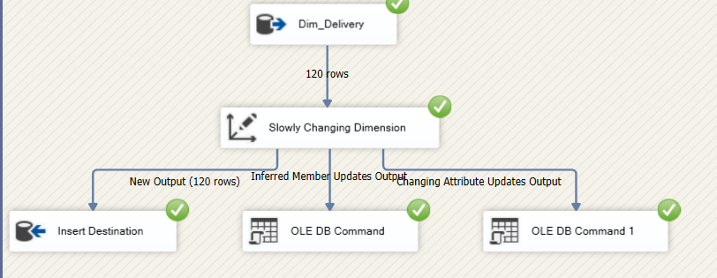
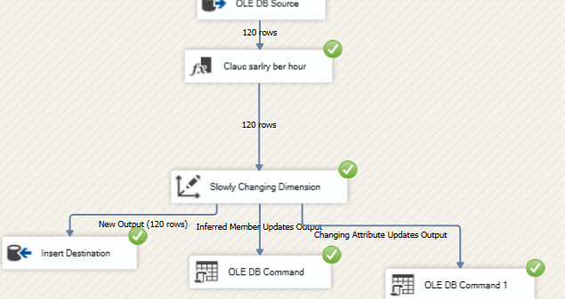
ETL Process in SSIS
Dim_Delivery
Dim_Employee

Slide 13
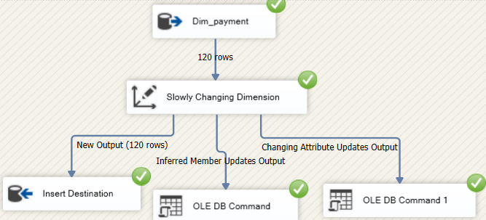
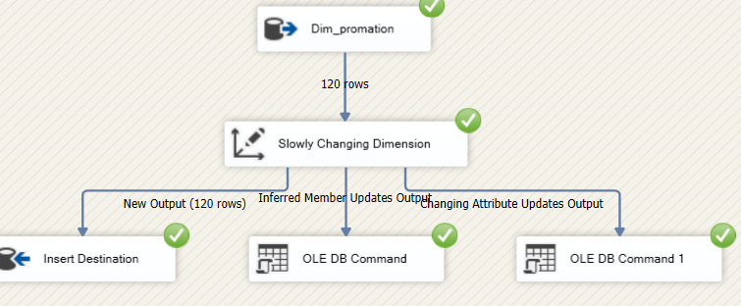
ETL Process in SSIS
Dim_payment
Dim_promation

Slide 14
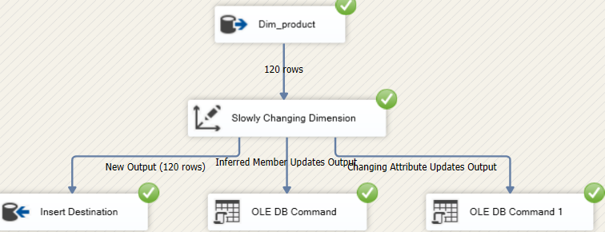
ETL Process in SSIS
Dim_product

Slide 15
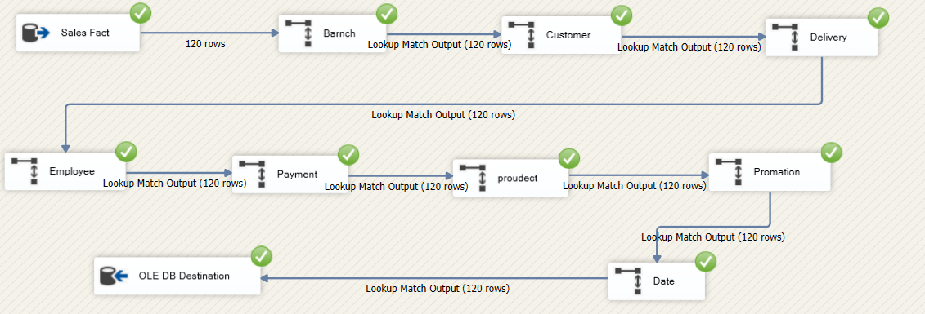
ETL Process in SSIS
Sales Fact

Slide 16
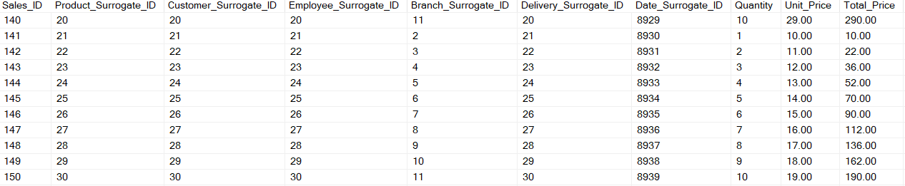
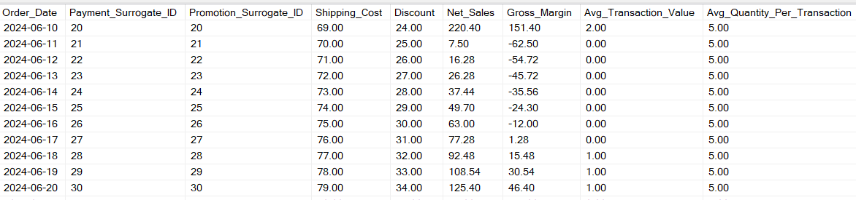
Date in FACT

Slide 17
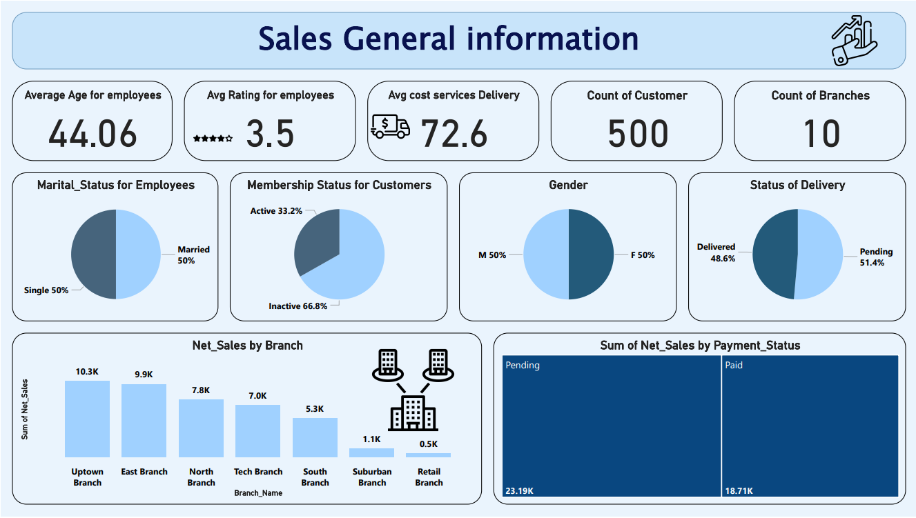

Slide 18
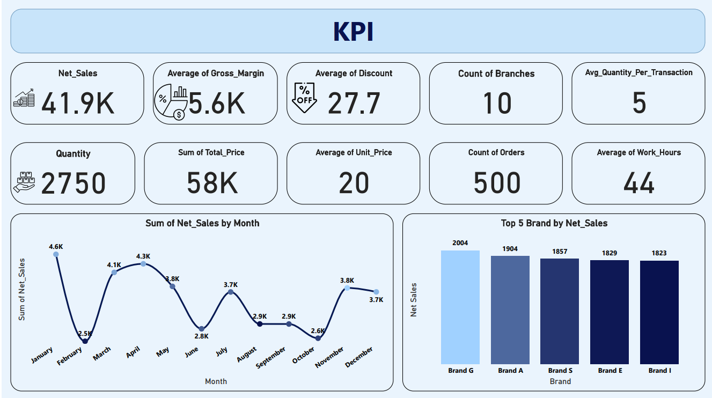

Slide 19
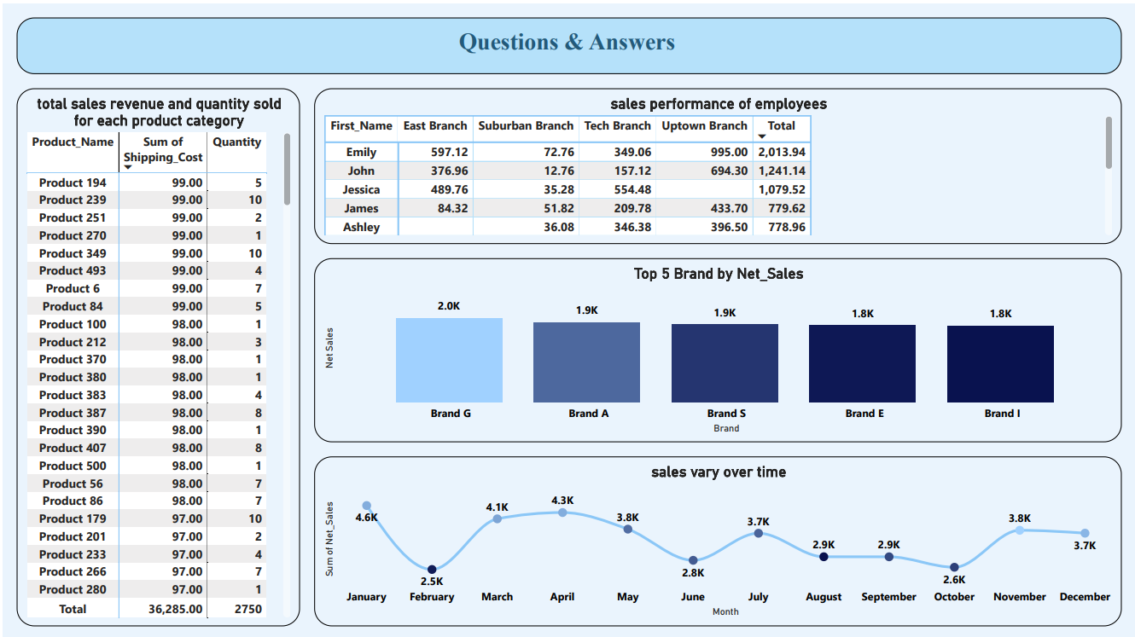

Slide 20
Introduction of Cloud
The Supermarket Management System Database project focuses on leveraging Azure to create an efficient and scalable data management system that supports various supermarket operations.
This system is designed to manage key data such as inventory levels, sales transactions, and customer relationships, allowing for optimized decision-making through data-driven insights.
The use of advanced analytics and reporting tools further supports business strategies by providing accurate, real-time information.
By migrating to Azure, this project ensures a robust, cloud-based infrastructure capable of handling large volumes of data with high performance.
Services like Azure SQL Database provide the foundation for storing and managing data, while processes such as CSV data extraction enable flexibility in handling and analyzing data outside of the cloud environment.

Slide 21
Azure Goals
1. Migrate Database to Azure SQL: Successfully transfer the existing schema and data from the local environment to Azure SQL Database, ensuring compatibility with Azure's cloud architecture. The database must meet the supermarket's growing demands for scalability, availability, and security. By migrating to Azure, the database benefits from cloud-native capabilities like automated backups, high availability, and integration with other Azure services.
2. Gather Business Information: Collaborate with stakeholders to identify and understand key business questions and objectives. This stage focuses on translating these business needs into actionable data requirements that will shape the data models, reports, and analytics developed throughout the project. Examples include tracking sales trends, optimizing inventory restocking, and analyzing customer purchasing behavior.

Slide 22
Azure Goals
3. Data Model Optimization: Develop and optimize a data model tailored for cloud performance on Azure SQL Database. This involves ensuring that the database structure supports high efficiency in querying and data retrieval, leveraging partitioning, indexing, and other optimization techniques to ensure the system can handle large-scale queries and deliver real-time results in a cloud environment.
4. Data Warehouse on Azure: Design and implement a comprehensive data warehouse hosted on Azure, which serves as the central repository for all supermarket data. This warehouse enables cross-functional reporting and analysis, combining data from various operational systems such as inventory, sales, and customer management, ensuring data consistency and integrity

Slide 23
Azure Goals
5. ETL with SSIS & Azure: Use SQL Server Integration Services (SSIS) in conjunction with Azure to design and implement efficient ETL (Extract, Transform, Load) processes. These processes are responsible for importing data into the data warehouse from different sources, including real-time data from the Azure database. This ensures that the data warehouse remains up-to-date with the latest transactional data and is ready for analysis and reporting.
6. Extract Data to CSV: Extract data from the Azure SQL Database into CSV files for additional analysis, sharing, and backups. This allows flexibility, as the data can be used in various external tools for further manipulation and insights. CSV extraction also helps in archiving historical data, providing easy access to past records while ensuring that the operational database remains lean and efficient.

Slide 24
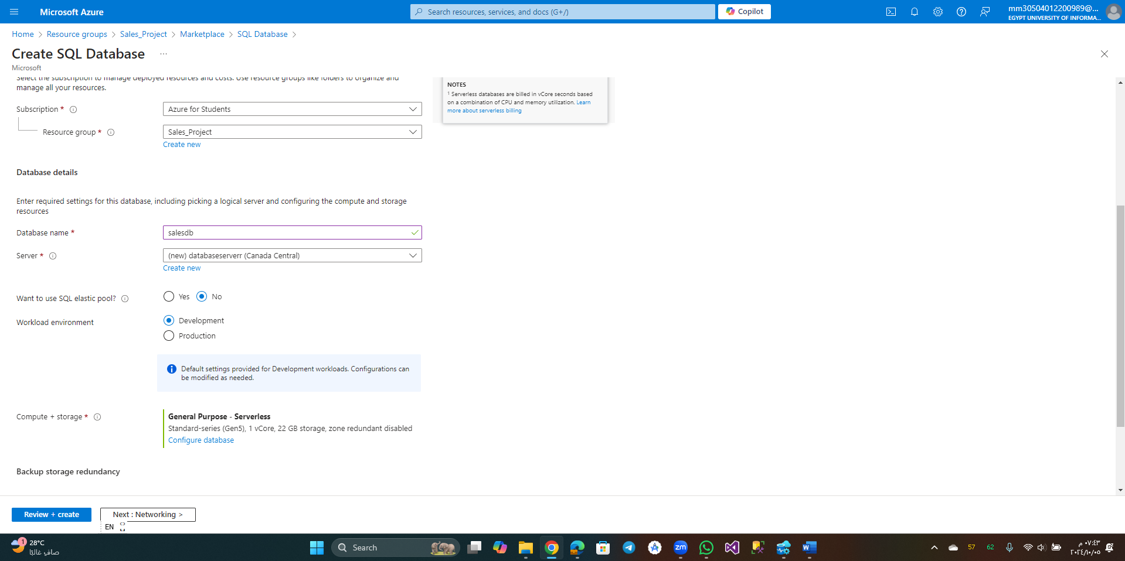
DataBase Creation : Ensure: connectivity method (public-end point)

Slide 25
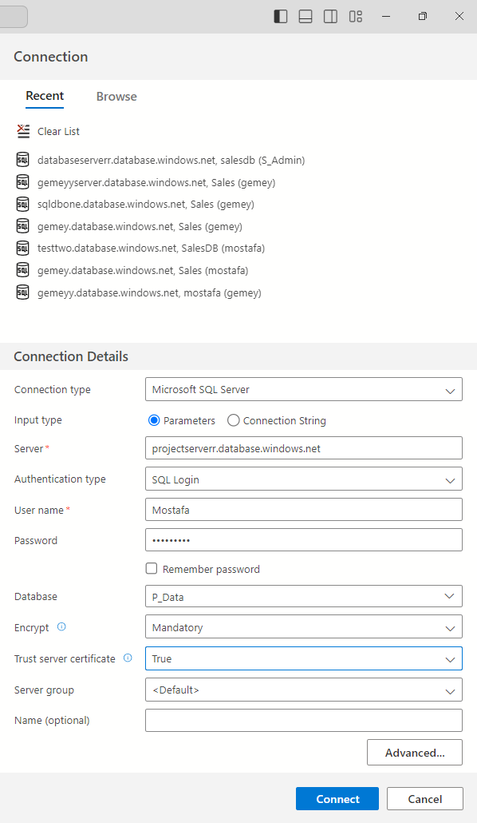
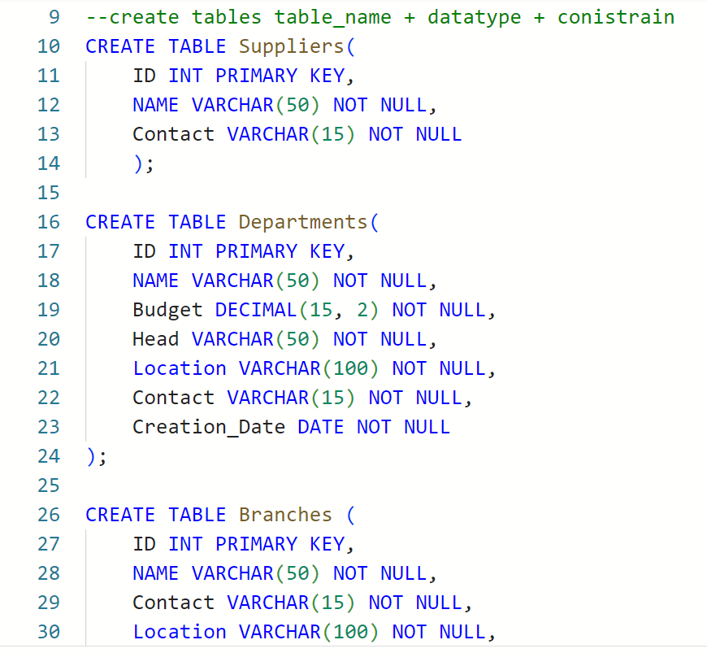
Connect It with azure data studio(open source cross-platform desktop) :
Create Tables : simpley using sql language

Slide 26
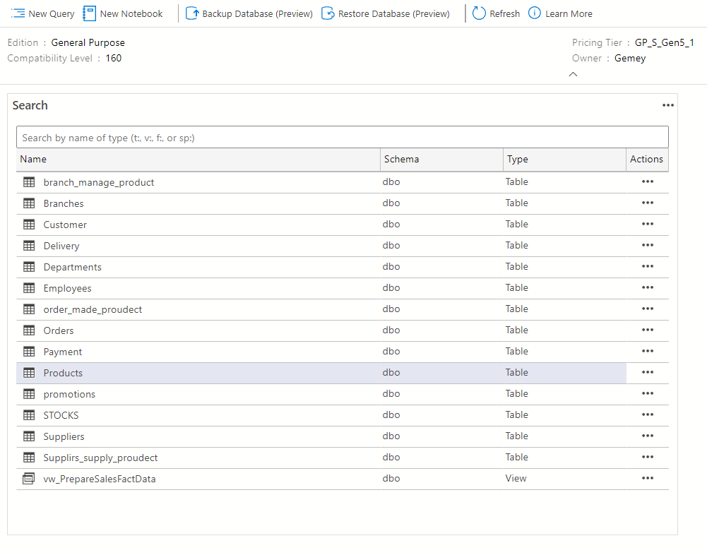
After creating the tables and Views and insert data:

Slide 27
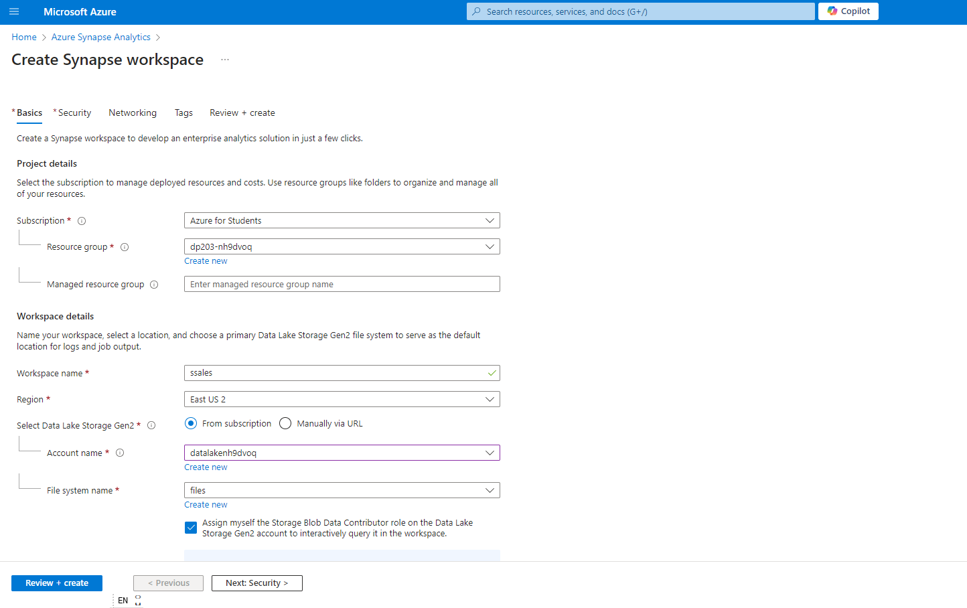
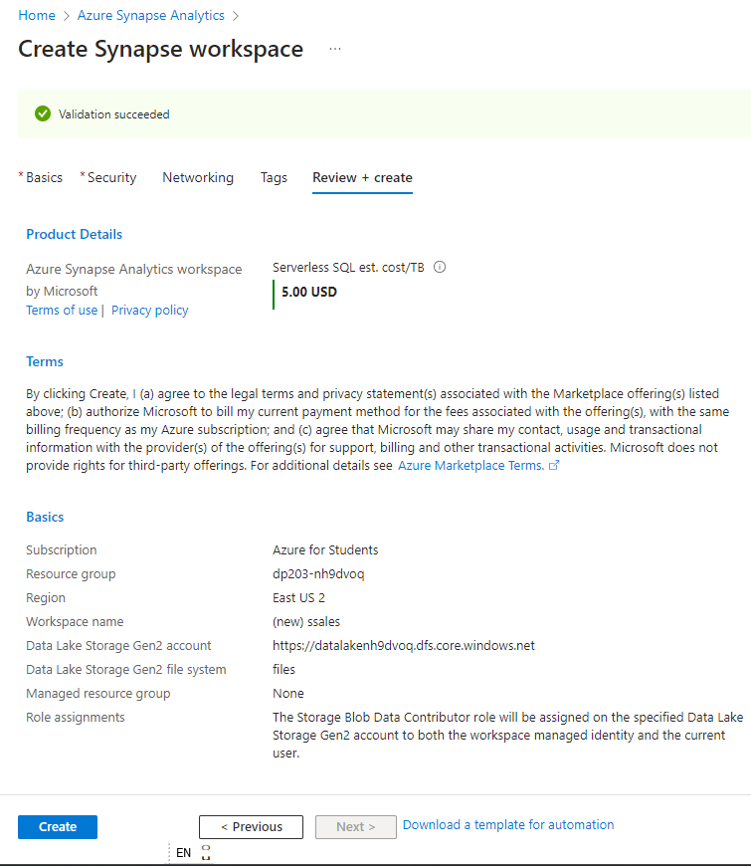
Create Azure Synapse Analitics :
Check Validation and cost

Slide 28
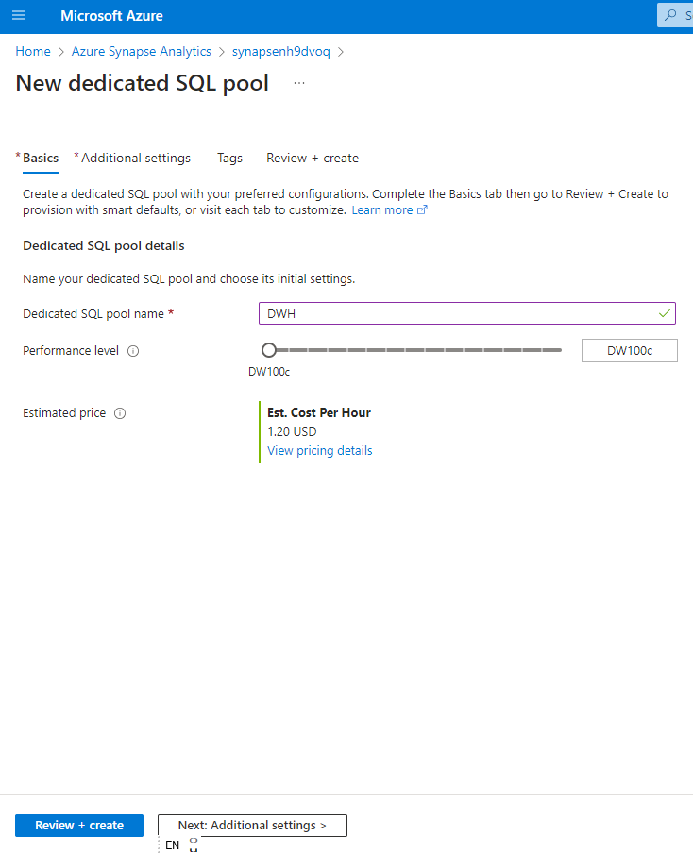
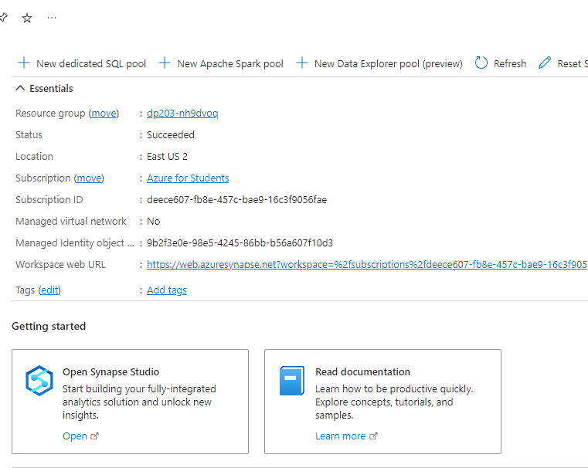
- Then go to the rasourc -Create sql pool in azure synapse for the dwh:

Slide 29
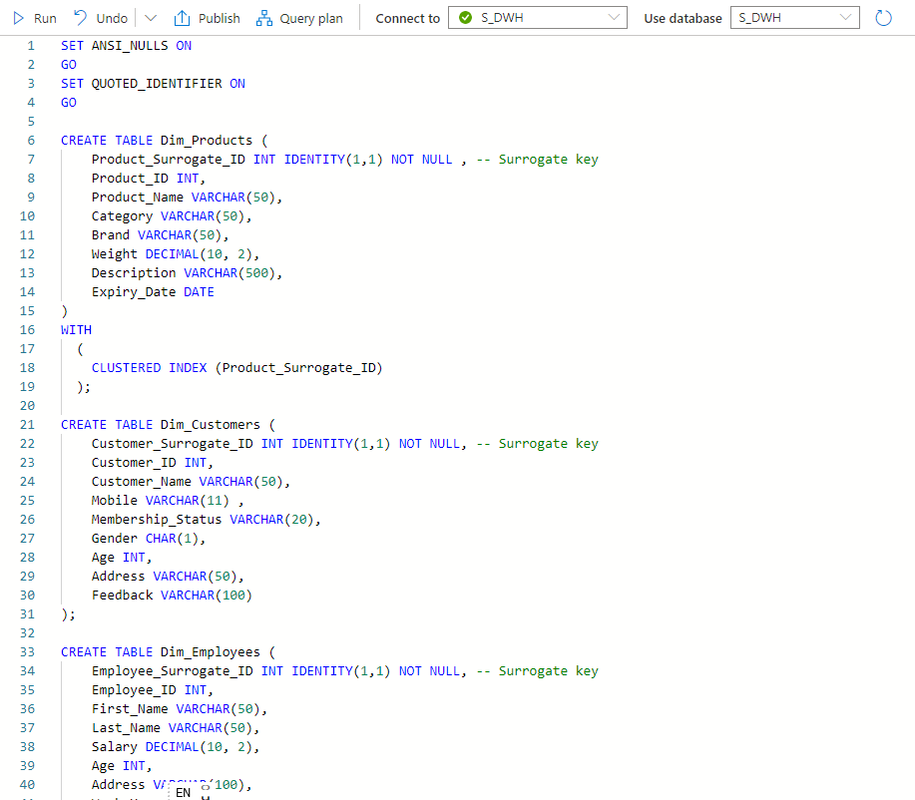
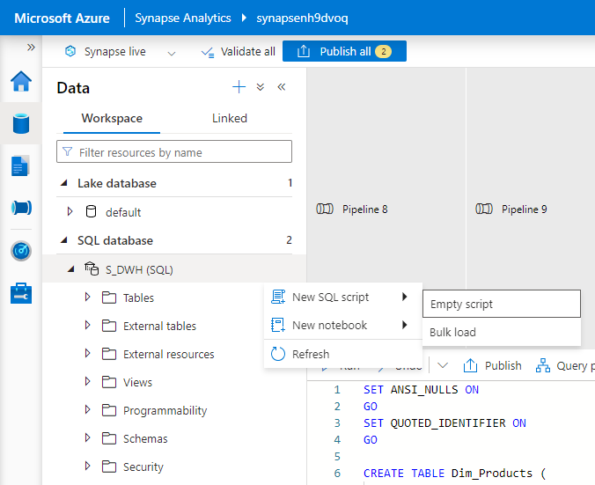
-Open synapse studio and go to data in the left side and select the sql pool (dwh) to create the dimensions.

Slide 30
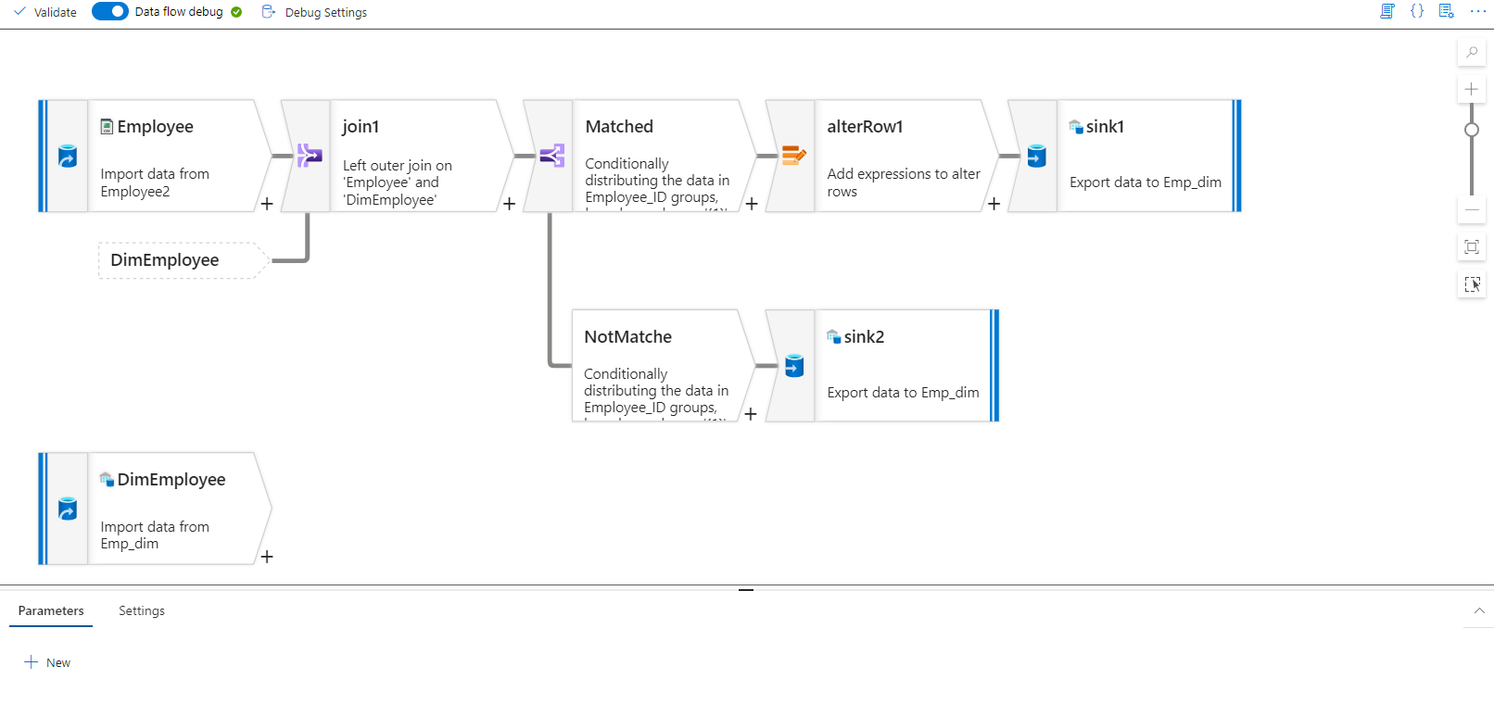
Use integrate (from the left side bar) to make ETL processes :
Slowly changing dimwntions type 1 -transformation using data flow

Slide 31
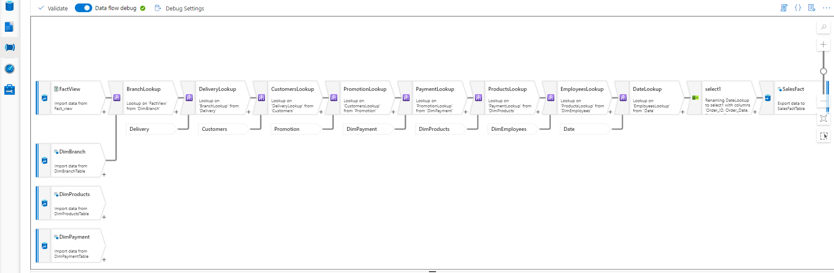
Look up dimetions tables and load data into fact tables using data flow

Slide 32
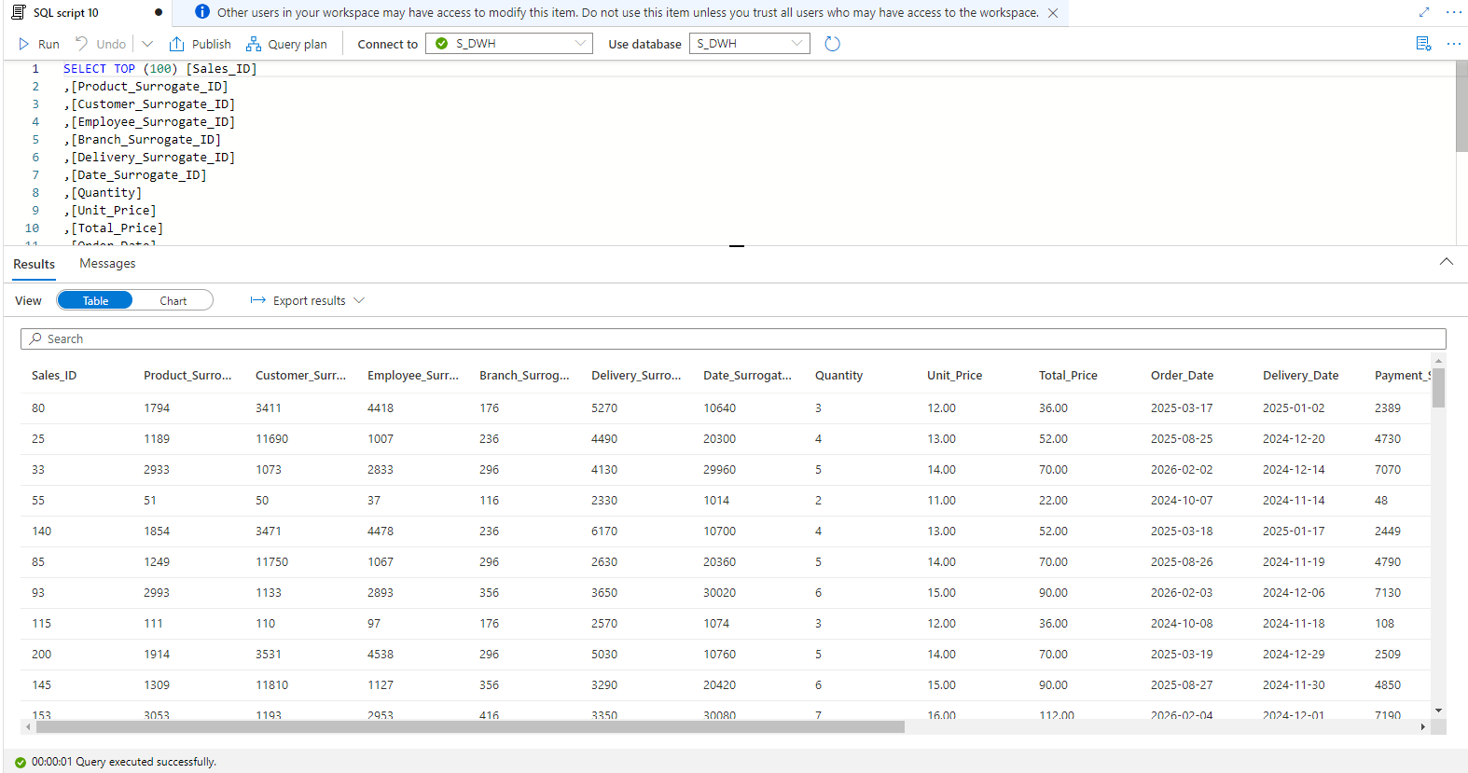
Data in fact table

Slide 33
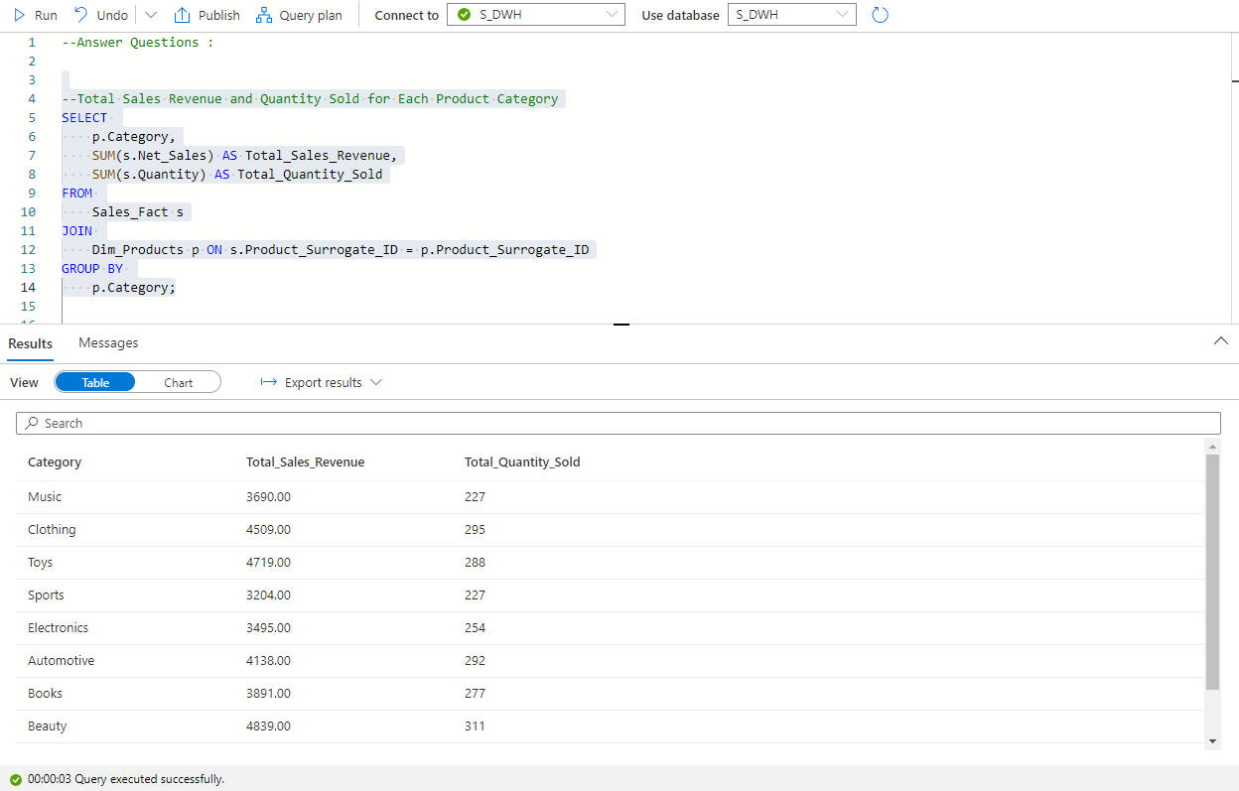
Answer Business Qustions

Slide 34
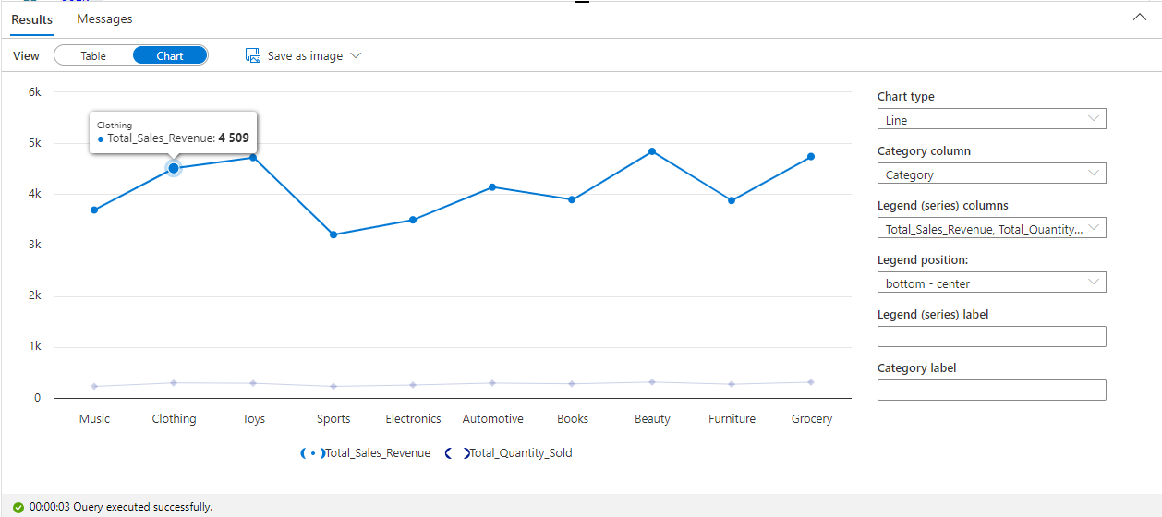
Visualization For Data

Slide 35
Analysis and Machine Learning
The data warehouse enables comprehensive data analysis and supports machine learning for predictive insights. Through techniques like demand forecasting, customer behavior analysis, and inventory optimization, we leverage historical data to make informed business decisions and improve operational efficiency.

Slide 36
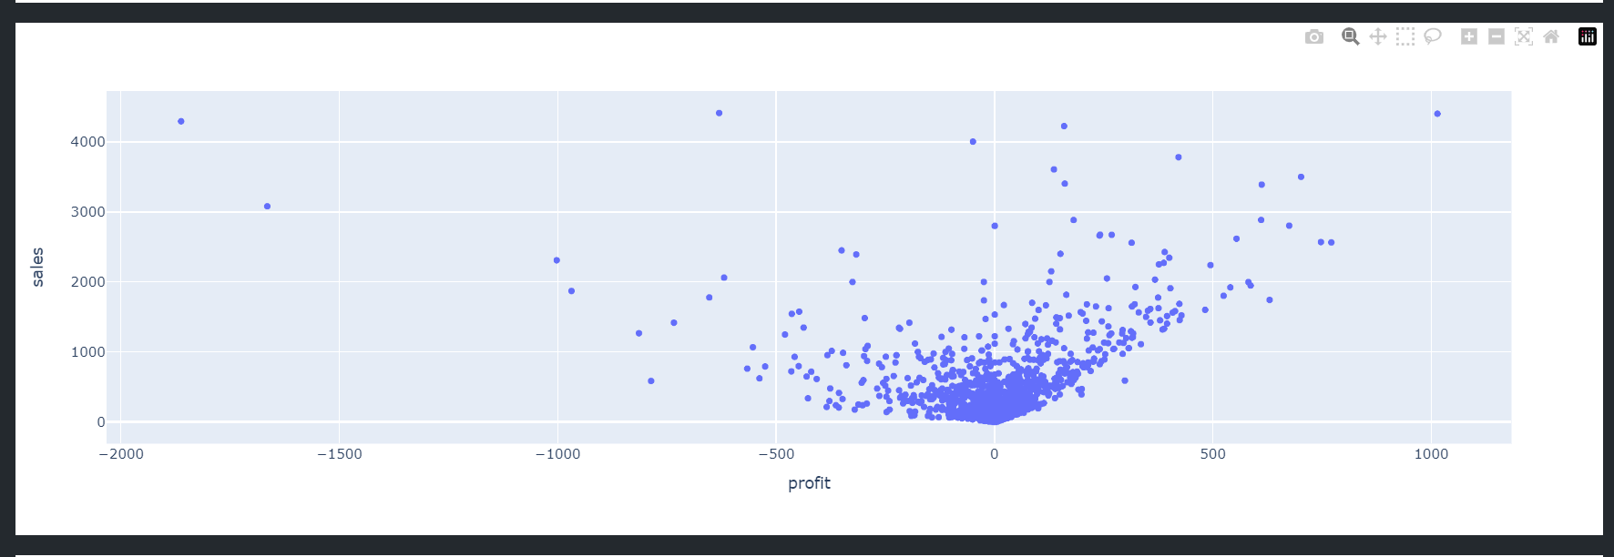
Charts
1- Profit vs Sales Scatter Plot
This scatter plot shows the relationship between profit and sales, highlighting a trend where higher sales
tend to result in positive profits, while low or negative profits occur with lower sales.

Slide 37
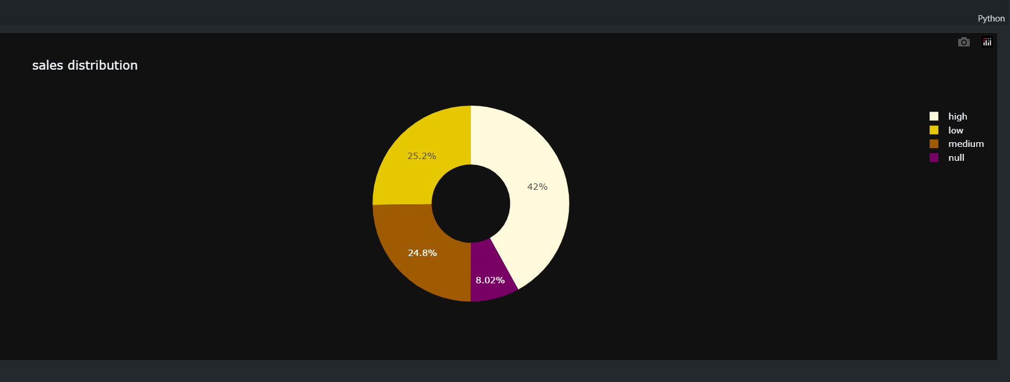
Charts
2- Sales Distribution Donut Chart
The sales distribution chart illustrates the percentage breakdown of sales across different
categories, with the largest portion falling under 'high' sales at 42%.

Slide 38
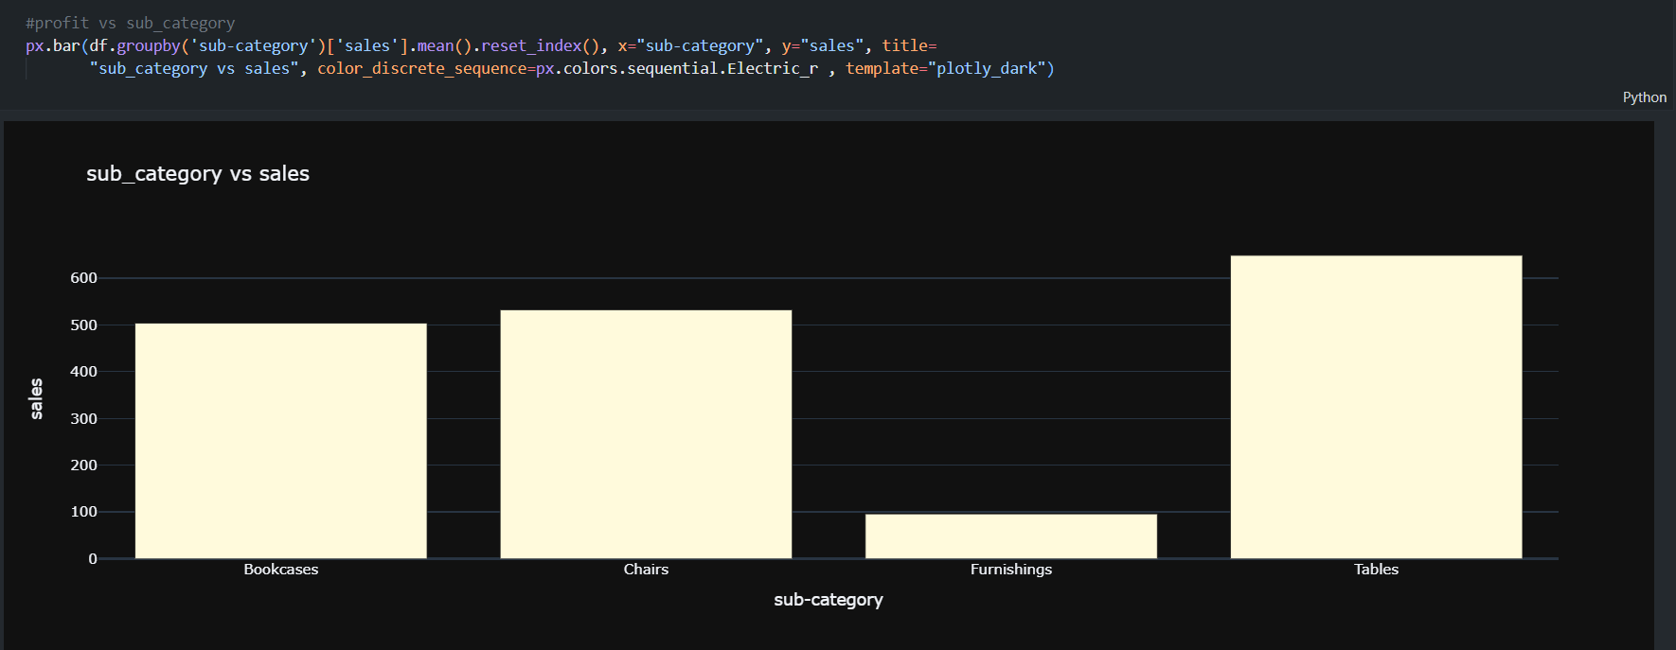
Charts
3- Sub-Category vs Sales Bar Chart
This bar chart compares the average sales across different sub- categories, with 'Tables' and
'Chairs' showing the highest sales performance

Slide 39
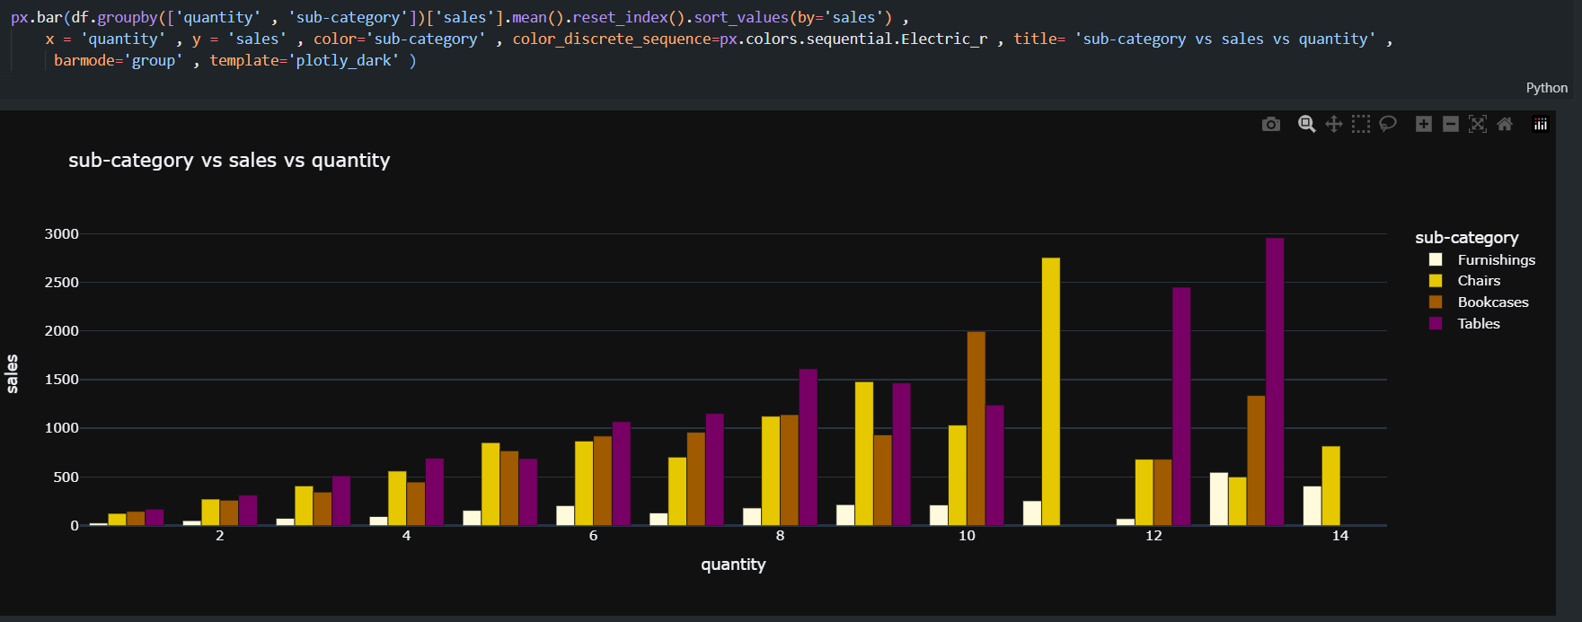
Charts
4- sub-category vs sales vs quantity
This chart shows the relationship between sub-categories, sales quantities, and total sales. It
highlights the variations in sales across different sub-categories, helping to identify the most in-
demand products relative to sales

Slide 40
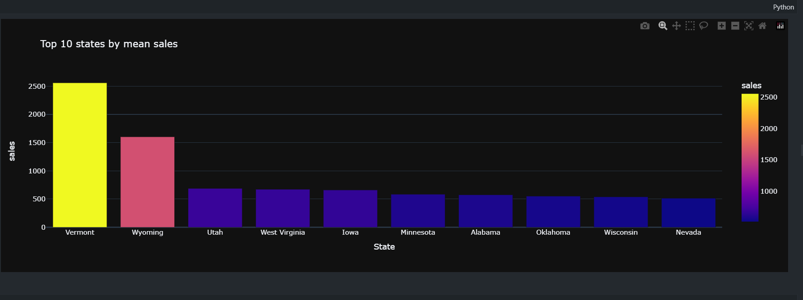
Charts
5- Top 10 states by mean sales
This chart displays the top 10 states by mean sales, offering a clear view of the most profitable
markets. The chart highlights significant differences in sales performance across the states.

Slide 41
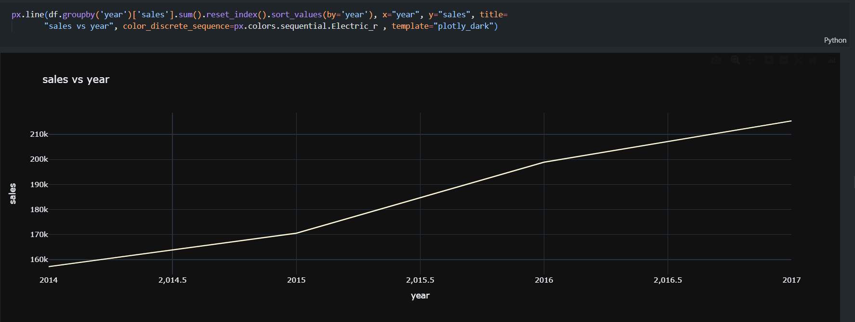
Charts
5- sales vs year
This line chart illustrates the trend of sales over the years. The consistent upward slope indicates
steady growth in sales from 2014 to 2017, reflecting positive performance over time.

Slide 42
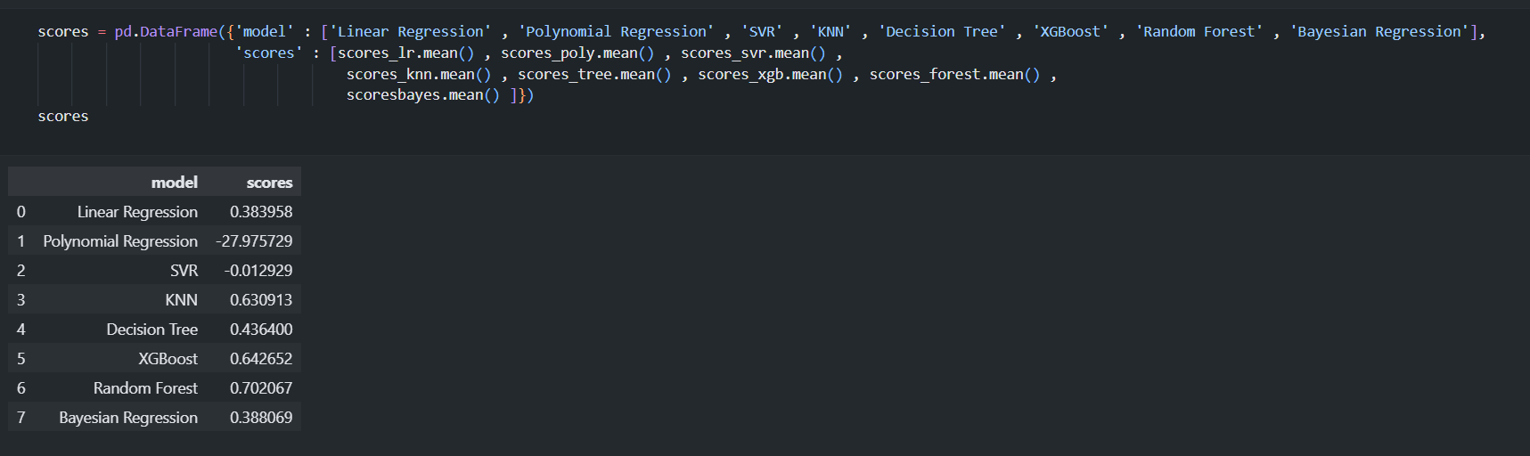
Machine Model
Model Comparison

Slide 43
Project Timeline
Week 1:
Entity-Relationship Diagram (ERD)
Schema
Review
Week 2:
Database Creation in MSSQL
Gathering Business Information
Review
Week 3:
Data Modeling
Data Warehouse
Review
Week 4:
ETL Process in SSIS
Reporting in Power BI
Review and Final Adjustments

Slide 44

Conclusion
The Supermarket Management System Database project is a comprehensive initiative that will significantly enhance the operational efficiency and decision-making capabilities of a supermarket. Through meticulous design, robust implementation, and advanced reporting, this project aims to deliver a powerful tool for managing and analyzing supermarket data. The successful completion of this project will not only streamline daily operations but also provide valuable insights that drive business growth.

